Slide 1
Item/doc 6.2 – Subsidiary bodies
Third Session of the Infrastructure Commission
(INFCOM-3, 15-19 April 2024)
Elected officers
19 April 2024

Slide 2
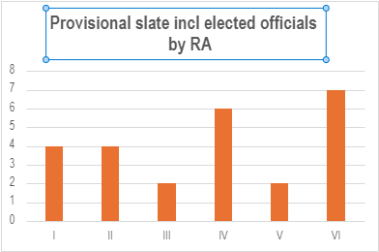
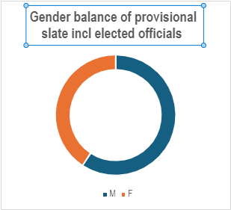
Provisional slate – regional association and gender balance

Slide 3
Thank you.
^{wmo.int}

